Slide 1


Slide 2




Power Bi, Tableau and Machine Learning

Slide 3
What is Power Bi, Tableau and Machine Learning
Power BI and Tableau are Business Intelligence (BI) tools used for data analysis and visualization, while machine learning involves using algorithms to enable computers to learn from data and make predictions.
Here, Machine Learning is used for Predictive analysis. Machine Learning includes supervised and unsupervised learning. It also uses regression and classification techniques

Slide 4
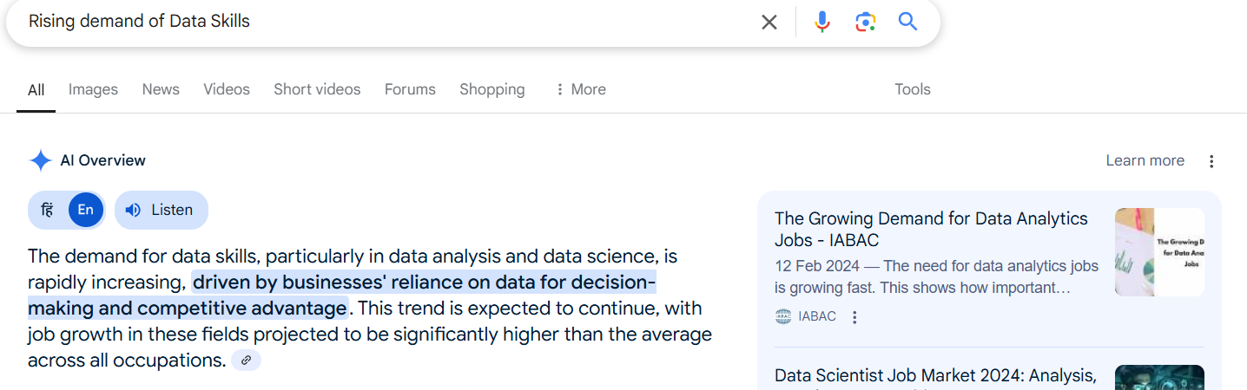
The Rising Demand for Data Skills
There is a growing demand for data skills. The U.S. Bureau of Labor Statistics projects a 22% job growth in data science by 2030. These skills lead to higher average salaries. Industries like Finance, Healthcare, and Retail are actively seeking these skills.

Slide 5
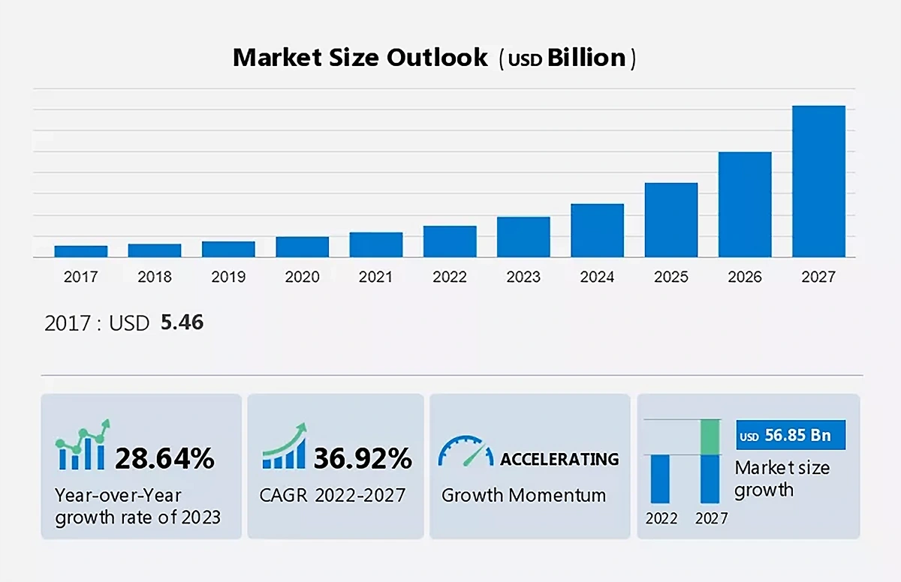
High demand of Data Analytics

Slide 6
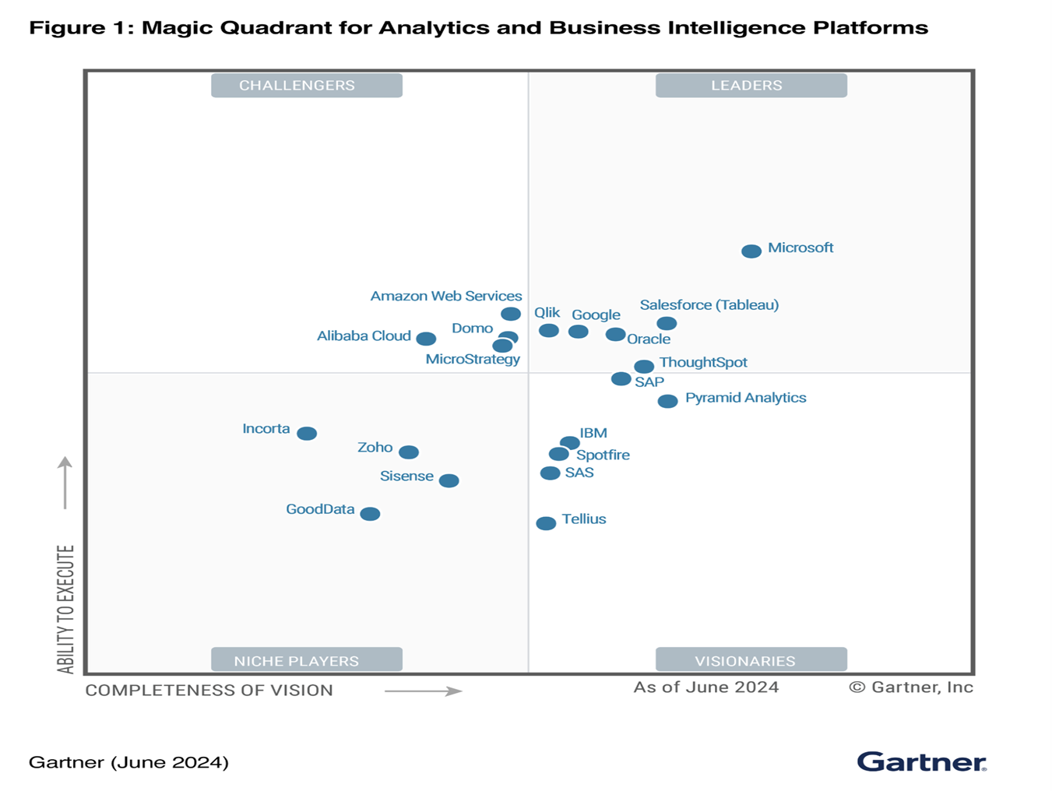
Where Power BI and Tableau stands in current market :

Slide 7
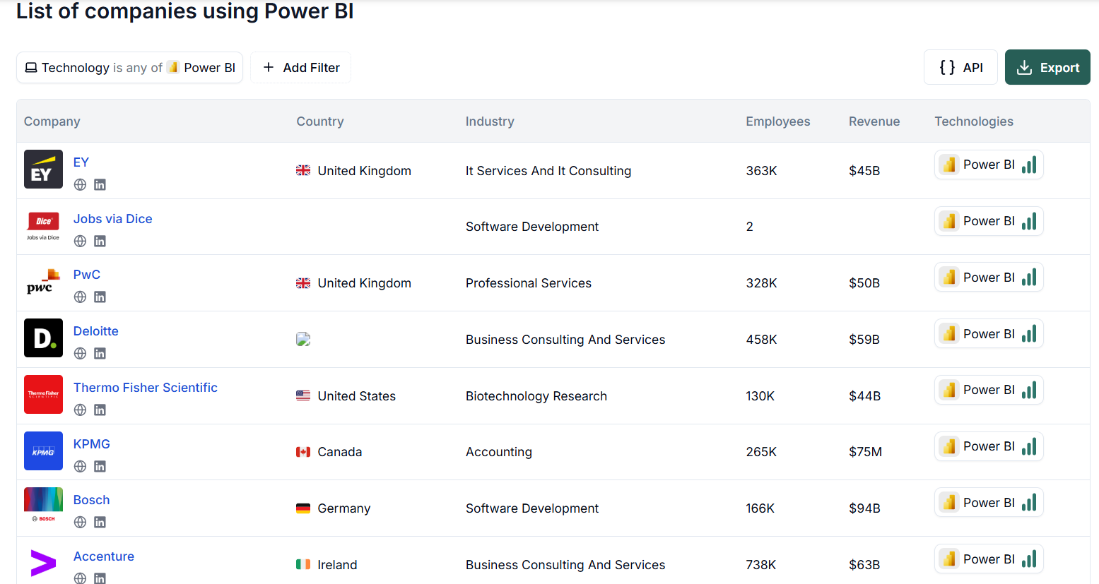
List of companies using Power Bi
https://theirstack.com/en/technology/power-bi

Slide 8
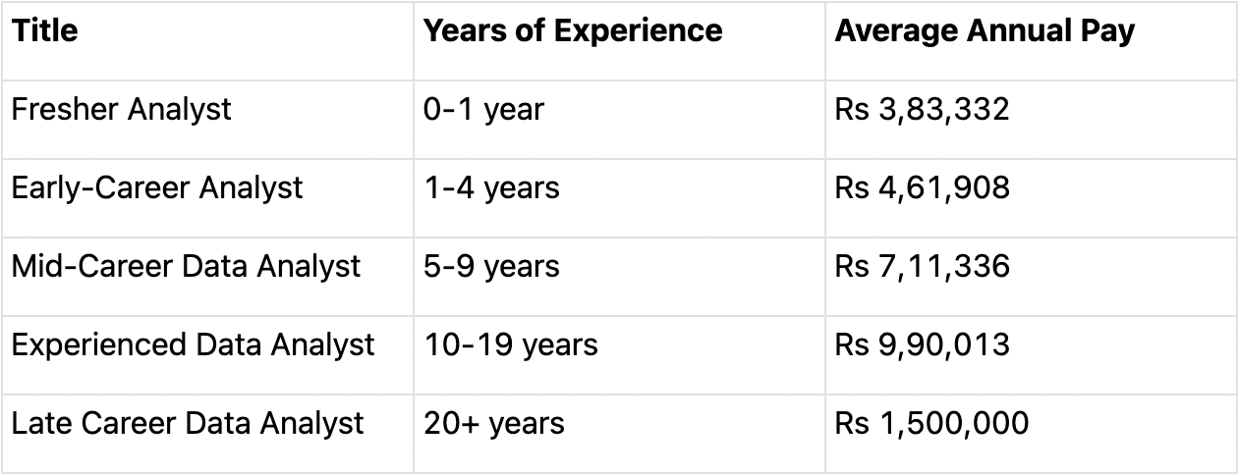
Salary Expectation according to 2024 insights

Slide 9
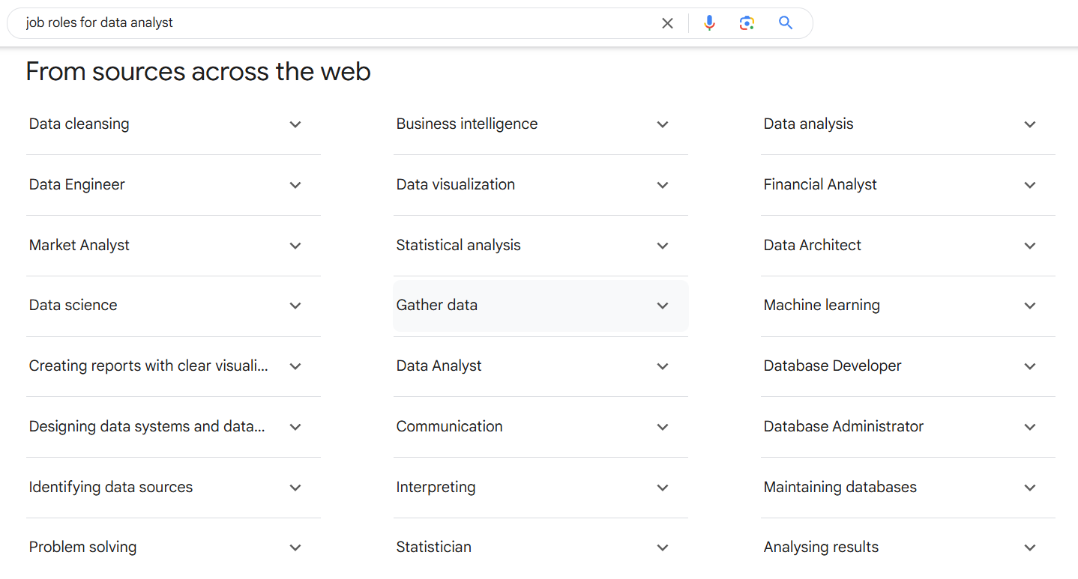
Job roles for Data Analyst

Slide 10
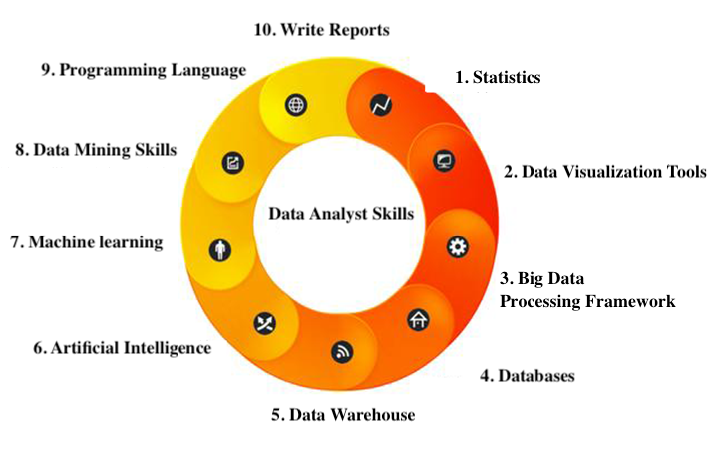
Skills need for Data Analyst according to leading companies

Slide 11
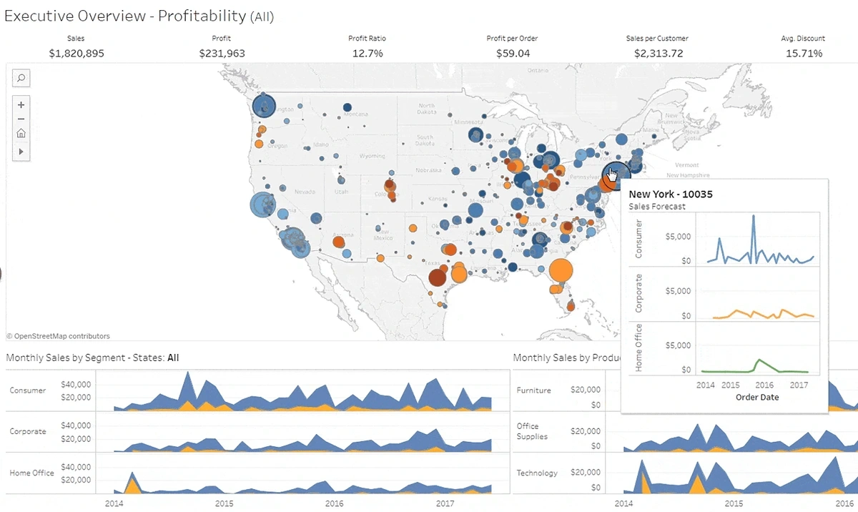
Example Insights of Data Analytics Dashboard

Slide 12
Thank you !

